Slide 1

QUEUING MODELS
SCHOOL OF DATA SCIENCE AND FORECASTING
DEVI AHILYA VISHWAVIDYALAYA, INDORE

Slide 2
Queuing Models
There are several situations in which waiting lines (queues) occur, e.g. waiting lines at supermarkets, ticket windows, restaurants, etc.
Most of these waiting line systems are characterized by variable arrival and service rates. Even though overall system capacity exceeds processing requirements, lines tends to form from time to time because of temporary overloads created by variability in either in service or arrival rates.
At other times, the reverse is also true; variability in demand results idle service facilities because of temporary absence of customers.
Queuing models and queuing analysis is useful to the decision makers to decide capacity of the systems.

Slide 3
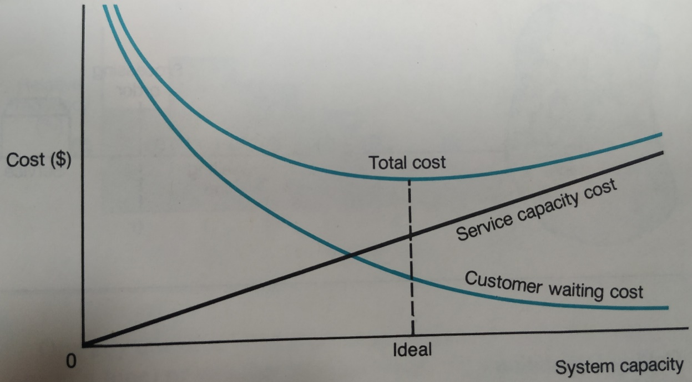
Objectives
The common goal in queuing system design is to attempt to balance the cost of proving service with the customers waiting for service. Both costs are in direct conflict – decrease in one will increase the other.
The total cost of service capacity and customer waiting cost is U-shaped because of this trade-off relationship.
The objective is to design the waiting line system with minimum total cost including cost of service capacity and customer waiting cost.

Slide 4
Elements and Characteristics
Queuing systems can be differentiated by certain characteristics, such as the number of servers or whether access to the system is unrestricted or limited.
Elements:
Calling Population: It refers to the pool of potential arrivals to the system, called customer source. If source is large enough that the probability of an arrival is not significantly influenced by the fact that some customers are waiting in line, we say that calling population is infinite. Examples-Systems open to general public-banks, post offices, restaurants, etc. If the number of jobs that require service causing the probability of another arrival to decrease, the calling population is called finite. Example-a machine operator may be responsible for loading and unloading five machines.
Customer Arrivals: The customers arrive at the systems in single units or in batches. Distribution of customer arrivals-generally Poisson. When arrival rate is Poison then inter-arrival time follows negative exponential distribution.
Waiting line: The waiting line consists of the customers who have arrived and waiting for service.
Processing Order: First come first served, service on priority, etc.
Service: Single channel, multiple channel.
Exit: Leaving the system after served or not served.

Slide 5
Measures of System Performance
Commonly Used Measures of Performance:
An additional measure is the total cost of the system, which is generally based on the cost of customer waiting time and cost of server time.
Measure | Description
L_{q} | The average number of customers waiting for service
L | The average number of customers in the system (waiting + being served)
P₀ | The probability of zero units in the system
ρ | The system utilization (percentage of time servers are busy serving customers)
W_{q} | The average time customers must wait for service
W | The average time customers spend in the system (i.e. waiting for service + service time)
M | The expected maximum number waiting for service for a given level of confidence

Slide 6
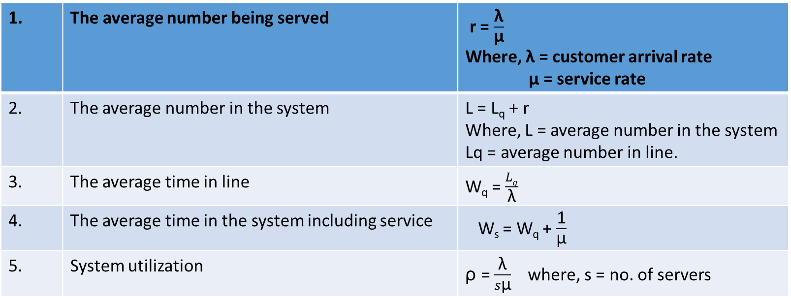
Basic Relationships
The most useful basic relationships are-
1. | The average number being served | r = $\frac{\text{λ}}{\text{µ}}$ Where, λ = customer arrival rate µ = service rate
2. | The average number in the system | L = L_{q} + r Where, L = average number in the system Lq = average number in line.
3. | The average time in line | W_{q} = $\frac{Lq}{\text{λ}}$
4. | The average time in the system including service | W_{s} = W_{q} + $\frac{\text{1}}{\text{µ}}$
5. | System utilization | ρ = $\frac{\text{λ}}{s\text{µ}}$ where, s = no. of servers

Slide 7
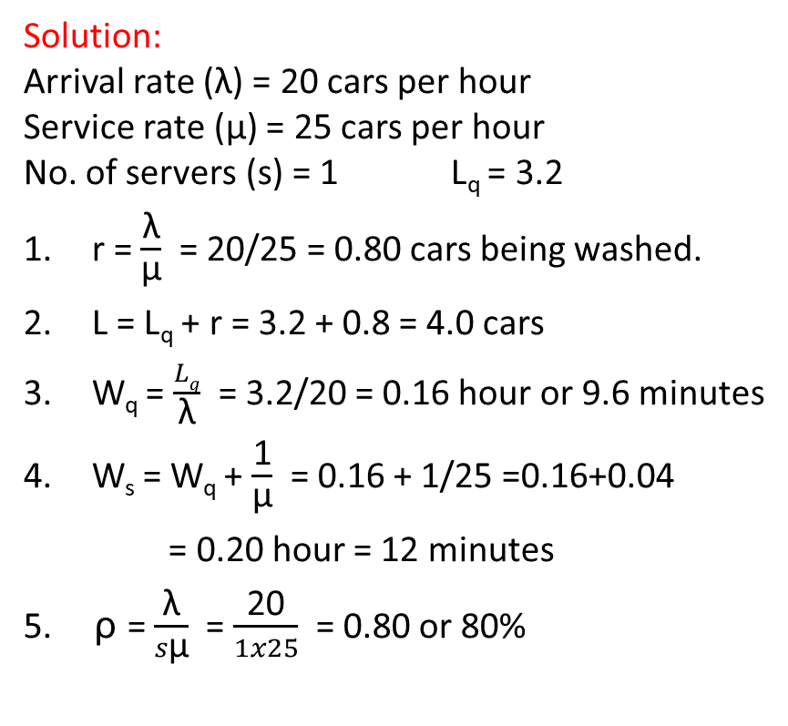
Queuing Models (Example)
The owner of a car wash company wants to start another car wash service. Based on experience, the owner estimates that the arrival rate for the proposed facility will be 20 cars per hour and service rate will be 25 cars per hour. Cars will be processed one at a time. Determine the following:
The average number of cars being washed.
The average number of cars in the system, where average number in line is 3.2
The average time in line
The average time cars spend in the system
The system utilization.
Solution:
Arrival rate ($\text{λ}$) = 20 cars per hour
Service rate ($\text{µ}$) = 25 cars per hour
No. of servers (s) = 1 L_{q} = 3.2
r = $\frac{\text{λ}}{\text{µ}}$ = 20/25 = 0.80 cars being washed.
L = L_{q} + r = 3.2 + 0.8 = 4.0 cars
W_{q} = $\frac{Lq}{\text{λ}}$ = 3.2/20 = 0.16 hour or 9.6 minutes
W_{s} = W_{q} + $\frac{\text{1}}{\text{µ}}$ = 0.16 + 1/25 =0.16+0.04
= 0.20 hour = 12 minutes
5. ρ = $\frac{\text{λ}}{s\text{µ}}$ = $\frac{\text{20}}{1x25}$ = 0.80 or 80%

Slide 8
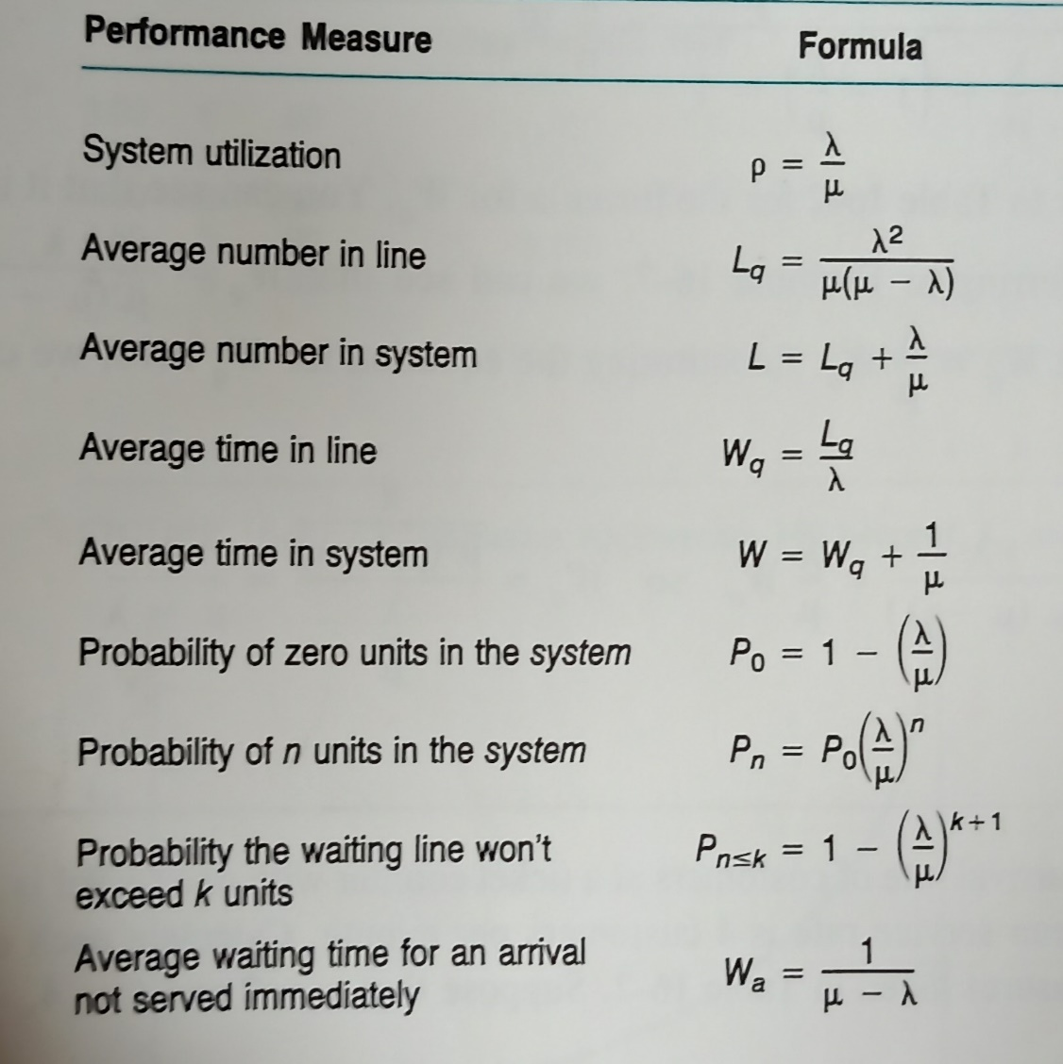
Queuing Models (Single-Channel)
One server or channel processes all customers.
A single channel model is appropriate when the following conditions exist:
One server or channel
A Poisson arrival rate
A negative exponential service time
Processing order is first come, first-served
The calling population is infinite
There is no limit on queue length.
Formulas:

Slide 9
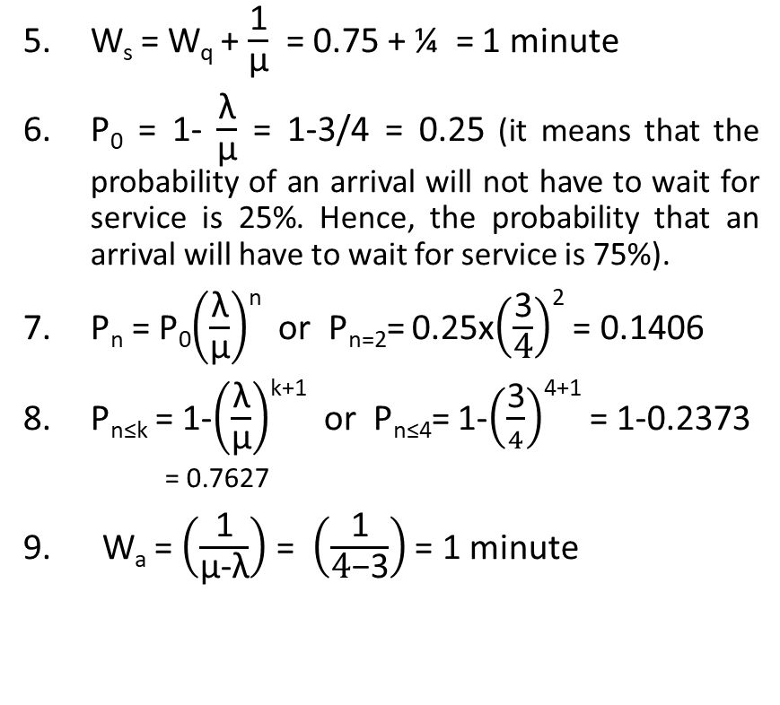
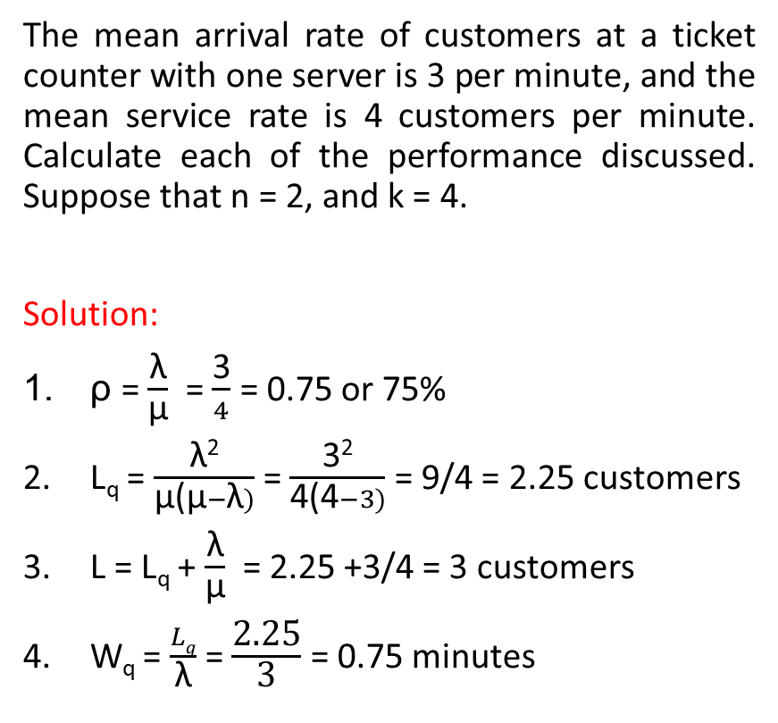
Queuing Models (Single-Channel)-Example
The mean arrival rate of customers at a ticket counter with one server is 3 per minute, and the mean service rate is 4 customers per minute. Calculate each of the performance discussed. Suppose that n = 2, and k = 4.
Solution:
ρ = $\frac{\text{λ}}{\text{µ}}$ = $\frac{\text{3}}{4}$ = 0.75 or 75%
L_{q} = $\frac{\text{λ}\text{2}}{\text{µ}\text{(}\text{µ}−\text{λ})}$ = $\frac{\text{3}\text{2}}{\text{4}\text{(}\text{4}−3)}$ = 9/4 = 2.25 customers
L = L_{q} + $\frac{\text{λ}}{\text{µ}}$ = 2.25 +3/4 = 3 customers
W_{q} = $\frac{Lq}{\text{λ}}$ = $\frac{\text{2.25}}{\text{3}}$ = 0.75 minutes
W_{s} = W_{q} + $\frac{\text{1}}{\text{µ}}$ = 0.75 + ¼ = 1 minute
P₀ = 1- $\frac{\text{λ}}{\text{µ}}$ = 1-3/4 = 0.25 (it means that the probability of an arrival will not have to wait for service is 25%. Hence, the probability that an arrival will have to wait for service is 75%).
P_{n} = P₀$\left(\frac{\text{λ}}{\text{µ}}\right)$^{n} or P_{n=2}= 0.25x$\left(\frac{\text{3}}{\text{4}}\right)$² = 0.1406
P_{n≤k} = 1-$\left(\frac{\text{λ}}{\text{µ}}\right)$^{k+1} or P_{n≤4}= 1-$\left(\frac{\text{3}}{4}\right)$⁴⁺¹ = 1-0.2373
= 0.7627
9. W_{a} = $\left(\frac{\text{1}}{\text{µ}\text{−}\text{λ}}\right)$ = $\left(\frac{\text{1}}{\text{4}\text{−}\text{3}}\right)$ = 1 minute

Slide 10
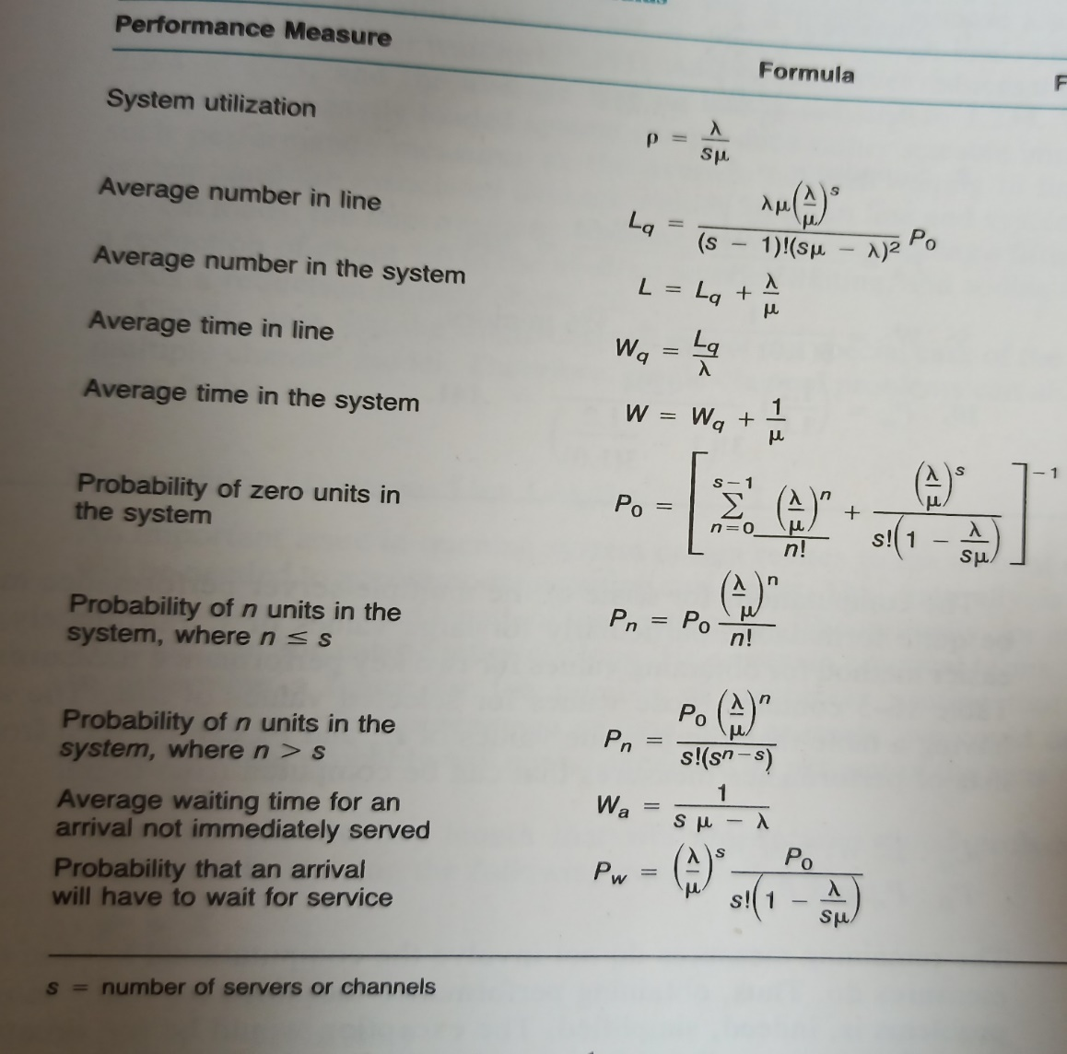
Queuing Models (Multiple-Channel)
More than one server or channel (Multiple server) process all customers.
The multiple-channel model is appropriate when the following conditions exist:
Multiple servers. All servers have the same mean service rate.
A Poisson arrival rate
A negative exponential service time
Processing order is first come, first-served
The calling population is infinite
There is no upper limit on queue length.
Formulas:

Slide 11
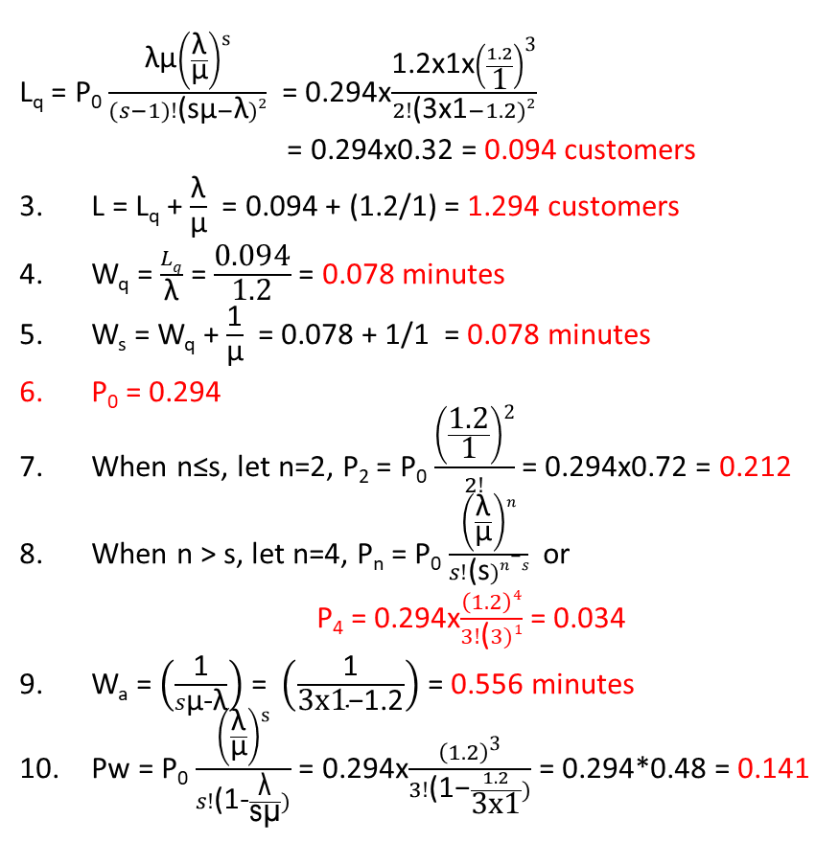
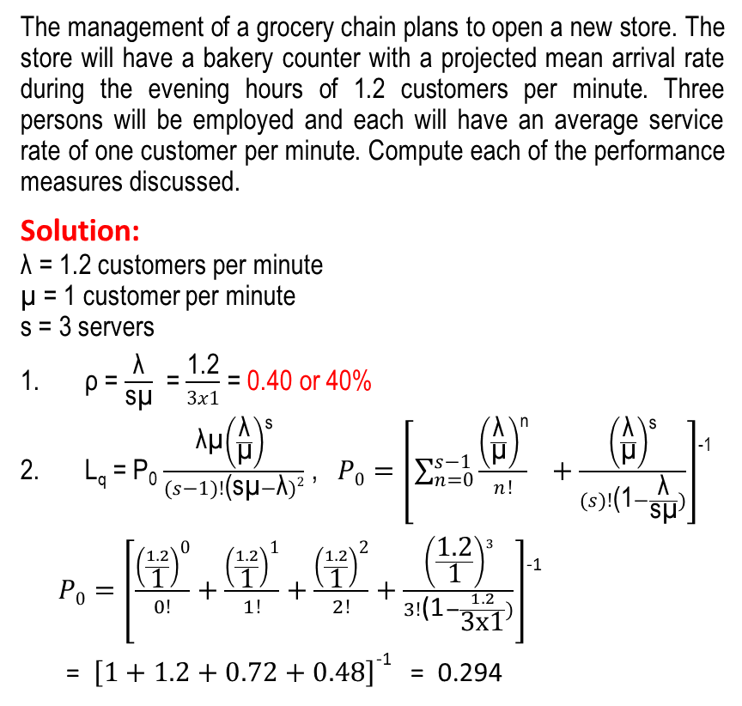
Queuing Models (Multiple-Channel)-Example
L_{q} = P₀ $\frac{\text{λ}\text{µ}\left(\frac{\text{λ}}{\text{µ}}\right)\text{s}}{(s−1)!\text{(}\text{s}\text{µ}−\text{λ})2}$ = 0.294x$\frac{\text{1.2}\text{x}\text{1}\text{x}\left(\frac{1.2}{\text{1}}\right)\text{3}}{2!\text{(}\text{3}\text{x}\text{1}−1.2)2}$
= 0.294x0.32 = 0.094 customers
L = L_{q} + $\frac{\text{λ}}{\text{µ}}$ = 0.094 + (1.2/1) = 1.294 customers
W_{q} = $\frac{Lq}{\text{λ}}$ = $\frac{\text{0.094}}{\text{1.2}}$ = 0.078 minutes
W_{s} = W_{q} + $\frac{\text{1}}{\text{µ}}$ = 0.078 + 1/1 = 0.078 minutes
P₀ = 0.294
When n≤s, let n=2, P₂ = P₀ $\frac{\left(\frac{\text{1.2}}{\text{1}}\right)\text{2}}{2!}$ = 0.294x0.72 = 0.212
When n > s, let n=4, P_{n} = P₀ $\frac{\left(\frac{\text{λ}}{\text{µ}}\right)n}{s!\text{(}\text{s})n−s}$ or
P₄ = 0.294x$\frac{\left(1.2\right)4}{3!\text{(}3)1}$ = 0.034
W_{a} = $\left(\frac{\text{1}}{s\text{µ}\text{−}\text{λ}}\right)$ = $\left(\frac{\text{1}}{\text{3}\text{x}\text{1}\text{−}\text{1.2}}\right)$ = 0.556 minutes
Pw = P₀ $\frac{\left(\frac{\text{λ}}{\text{µ}}\right)\text{s}}{s!\text{(}\text{1−}\frac{\text{λ}}{\text{s}\text{µ}})}$ = 0.294x$\frac{\left(1.2\right)\text{3}}{3!\text{(1−}\frac{1.2}{\text{3}\text{x}\text{1}})}$ = 0.294*0.48 = 0.141
The management of a grocery chain plans to open a new store. The store will have a bakery counter with a projected mean arrival rate during the evening hours of 1.2 customers per minute. Three persons will be employed and each will have an average service rate of one customer per minute. Compute each of the performance measures discussed.
Solution:
$\text{λ}$ = 1.2 customers per minute
$\text{µ}$ = 1 customer per minute
s = 3 servers
ρ = $\frac{\text{λ}}{\text{s}\text{µ}}$ = $\frac{\text{1.2}}{3x1}$ = 0.40 or 40%
L_{q} = P₀ $\frac{\text{λ}\text{µ}\left(\frac{\text{λ}}{\text{µ}}\right)\text{s}}{(s−1)!\text{(}\text{s}\text{µ}−\text{λ})2}$ , $P0=\left[\sum_{n=0}^{s−1}{\frac{\left(\frac{\text{λ}}{\text{µ}}\right)\text{n}}{n!} } +\frac{\left(\frac{\text{λ}}{\text{µ}}\right)\text{s}}{(s)!\text{(}\text{1}−\frac{\text{λ}}{\text{s}\text{µ}})}\right]$⁻¹
$P0=\left[\frac{\left(\frac{1.2}{\text{1}}\right)\text{0}}{0!}+\frac{\left(\frac{1.2}{\text{1}}\right)\text{1}}{1!}+\frac{\left(\frac{1.2}{\text{1}}\right)\text{2}}{2!}+\frac{\left(\frac{\text{1.2}}{\text{1}}\right)3}{3!\text{(1}−\frac{1.2}{\text{3}\text{x}\text{1}})}\right]$⁻¹
= $\left[1+1.2+0.72+0.48\right]$⁻¹ = 0.294

Slide 12
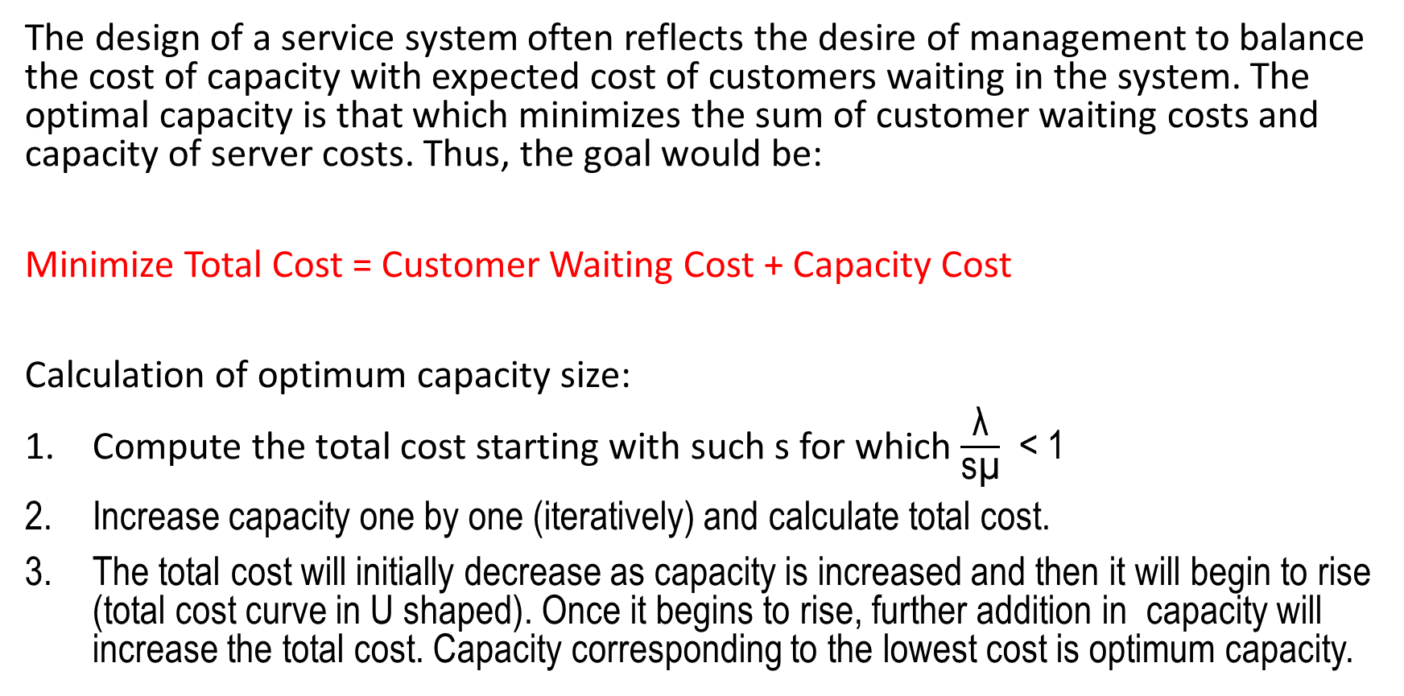
COST CONSIDERATIONS:
The design of a service system often reflects the desire of management to balance the cost of capacity with expected cost of customers waiting in the system. The optimal capacity is that which minimizes the sum of customer waiting costs and capacity of server costs. Thus, the goal would be:
Minimize Total Cost = Customer Waiting Cost + Capacity Cost
Calculation of optimum capacity size:
Compute the total cost starting with such s for which $\frac{\text{λ}}{\text{s}\text{µ}}$ < 1
Increase capacity one by one (iteratively) and calculate total cost.
The total cost will initially decrease as capacity is increased and then it will begin to rise (total cost curve in U shaped). Once it begins to rise, further addition in capacity will increase the total cost. Capacity corresponding to the lowest cost is optimum capacity.

Slide 13
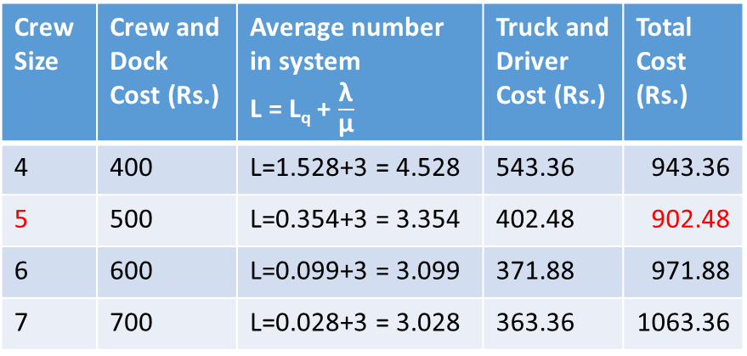
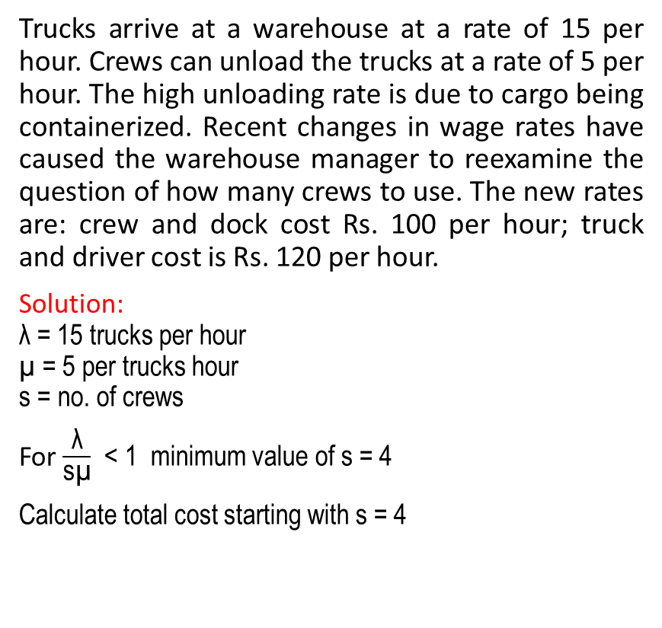
COST CONSIDERATIONS (EXAMPLE):
Trucks arrive at a warehouse at a rate of 15 per hour. Crews can unload the trucks at a rate of 5 per hour. The high unloading rate is due to cargo being containerized. Recent changes in wage rates have caused the warehouse manager to reexamine the question of how many crews to use. The new rates are: crew and dock cost Rs. 100 per hour; truck and driver cost is Rs. 120 per hour.
Solution:
$\text{λ}$ = 15 trucks per hour
$\text{µ}$ = 5 per trucks hour
s = no. of crews
For $\frac{\text{λ}}{\text{s}\text{µ}}$ < 1 minimum value of s = 4
Calculate total cost starting with s = 4
Crew Size | Crew and Dock Cost (Rs.) | Average number in system L = L_{q} + $\frac{\text{λ}}{\text{µ}}$ | Truck and Driver Cost (Rs.) | Total Cost (Rs.)
4 | 400 | L=1.528+3 = 4.528 | 543.36 | 943.36
5 | 500 | L=0.354+3 = 3.354 | 402.48 | 902.48
6 | 600 | L=0.099+3 = 3.099 | 371.88 | 971.88
7 | 700 | L=0.028+3 = 3.028 | 363.36 | 1063.36
Crew size of 5 is optimal.
It is not necessary to calculate total cost for crew size larger than six.

Slide 14
Thank You!
Dr. V.B.Gupta
+ 91 99933 50547
vbgupta.davv@gmail.com

